Slide 1

SQL Security 1 - Introduction
SQLBits 2020

Slide 2
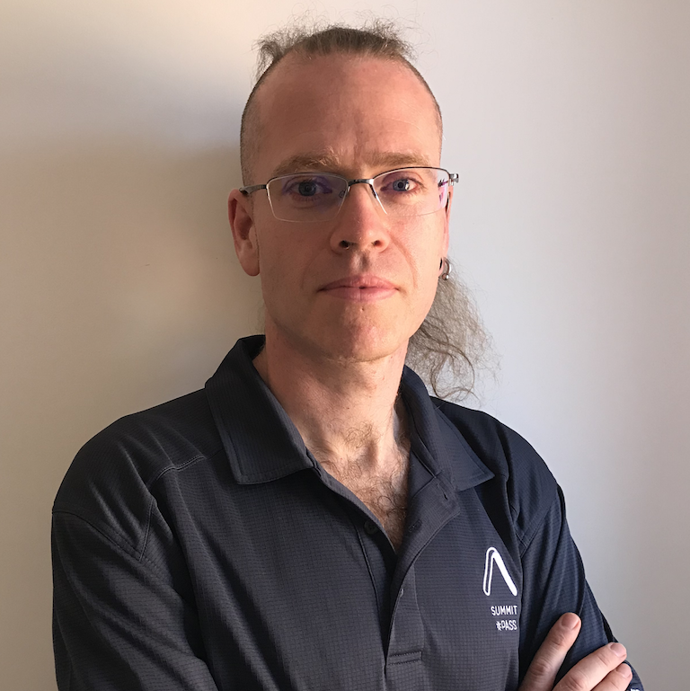


Stuart Moore
stuart@stuart-moore.com
@napalmgram
https://stuart-moore.com
20+ years pushing data around many platforms using whatever tools he can find
Organises DataRelay, Nottingham SQL Server and PowerShell Usergroups, and Nottingham Global Azure Bootcamp
dbatools contributor (Restore/Backups)
Microsoft MVP Data Plaform
ISC2 CISSP Certified

Slide 3
Timings
Will try to keep a bio/drinks break of 5-10 minutes an hour
Hard to concentrate for more than 50 minutes as a learner
Lunch should be about 12:30. Probaby for 1 hour. I’ll be quicker in case anyone wants to ask questions on the morning’s material
Finishing by 17:00

Slide 4
Housekeeping
Please ask questions as we go
A lot of the material in this session is opinion backed up by policies
It may not all fit in at your organisation
It may be above your paygrade atm, but one day
The policies come from ISC² a respected industy body who take them from ISO standards
There is a monitored chat window to post them in
If you don’t understand something, you’re probably not the only one
My job is to help you understand
Feel free to start a discussion if you feel it just wouldn’t work for you. I want to learn as well, and discussion was part of the original plan before things changed

Slide 5
Demo environment
I’m Running mine in Azure today
1 Domain Controller
1 SQL Server with 2 instances
1 jumpbox/client machine
Do not need to be powerful machines
I’m using Windows 2019 and SQL Server 2019
I’ll upload demo scripts after the last section so that they include anything else we try during the day

Slide 6
Agenda
Intro
What is Security
Build Secure
Encryption
Code Secure
Test & Audit
Disaster!!!!
Review / Q&A

